Slide 1
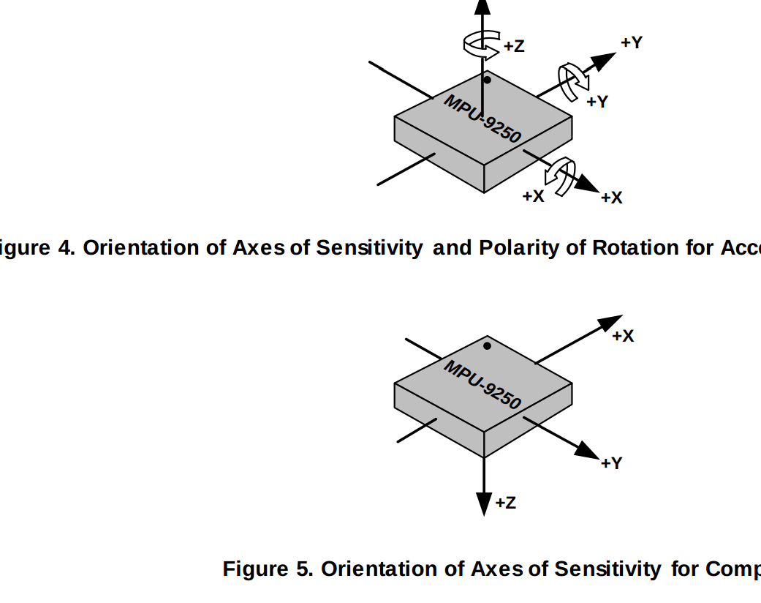
Sensor integration, calibration testing, fusion and Estimation.
-Damodar Pokhrel

Slide 2

Outline
Introduction & methodlogy
GPS and degree conversion
Bno055 sensor integration
Data smoothing
Orientation estimation using madwrik algorithm
Position estimation using Kalman estimation
Python code demo.

Slide 3
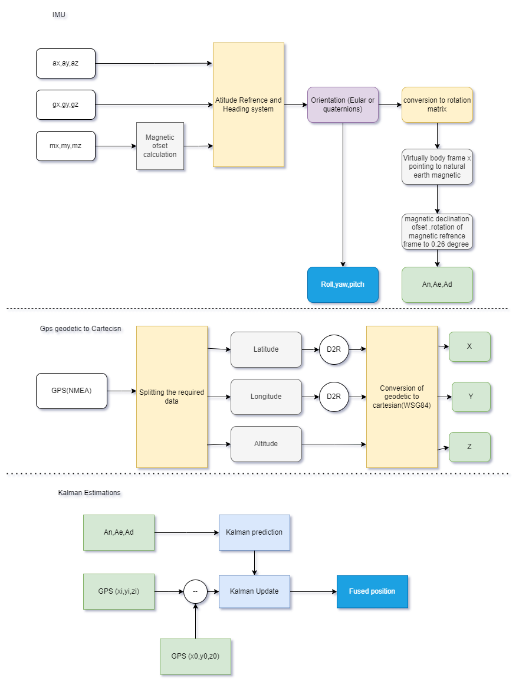
Methodology of the project

Slide 4
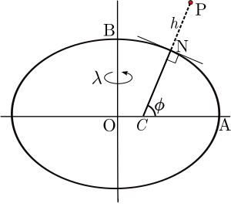
GPS:
NMEA: National Marine Electronics Association
Provides latitude longitude altitude ,speed and time
The gps use geodetic earth reference frame where earth is consider as a ellipse or WGS84 model.
Local tangent plane.

Slide 5
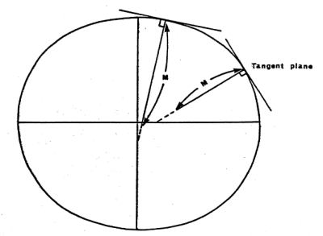
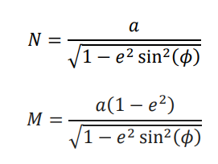
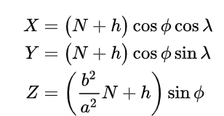

conversion

Slide 6
Acclerometer.
Used sensor BNO055: 9 axis IMU.
Integrated sensor of accelerometer ,gyroscope and magnetometer
Madgwick algorithm (AHRS) implemented to estimate the orientation.
AHRS: Atitude heading and reference system.

Slide 7
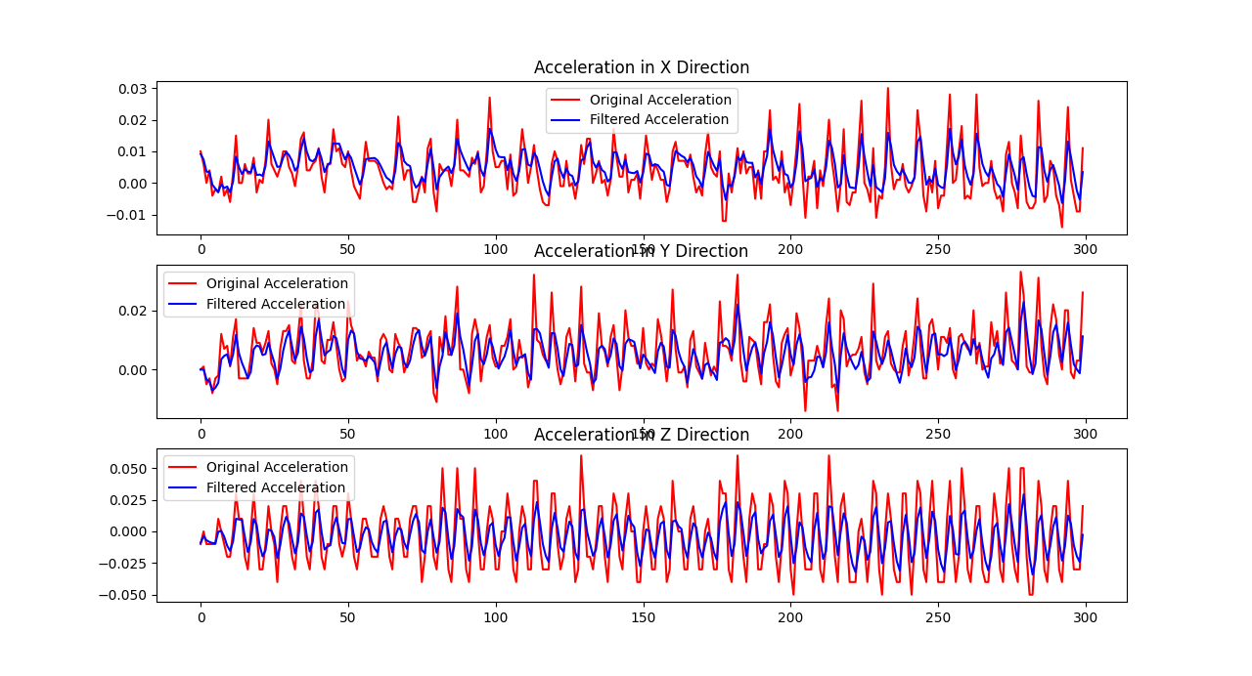
Data preprocessing and offset calculation
1st Kalman filter was used to smoothing the acceleration data to make noise free.
One problem was arises i.e is lead lag due to estimation.

Slide 8
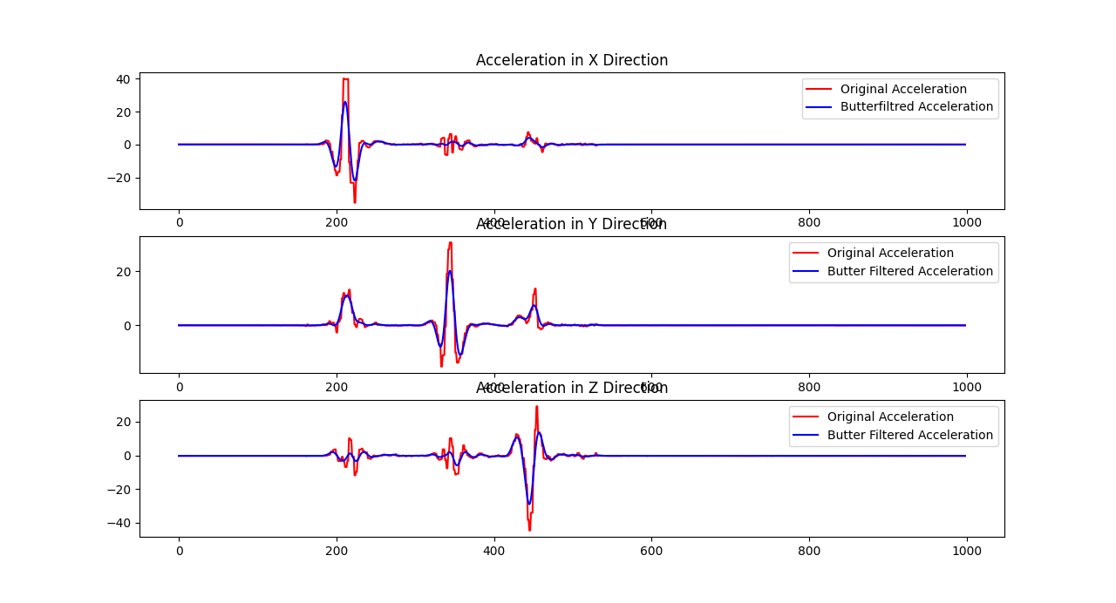
Data preprocessing and offset calculation
Then from study , Butterworth 2nd order filter is good candidate for smoothing the data.
The lead lag problem is solved by this filter.

Slide 9
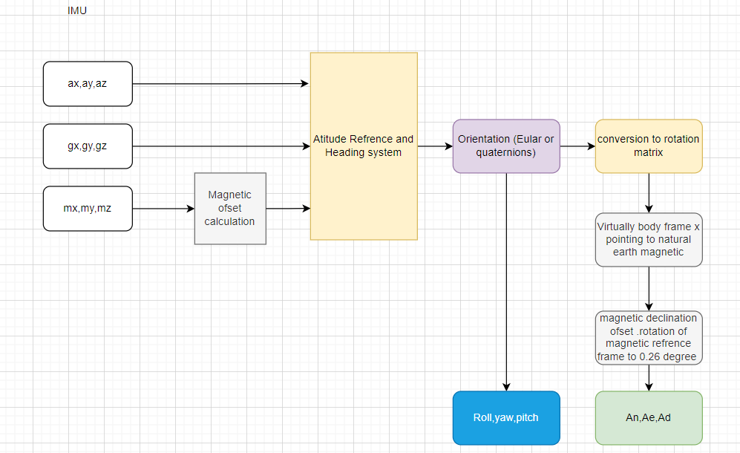
IMU

Slide 10
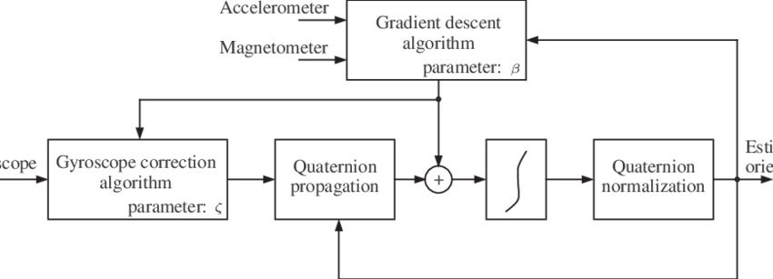
Madgwick Gradient decent algorithm for orientation optimization.

Slide 11
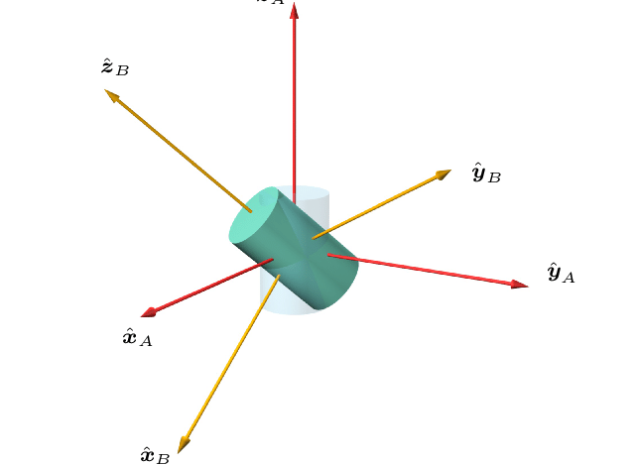
Rotation of body frame virtually to align with magnetic frame

Slide 12
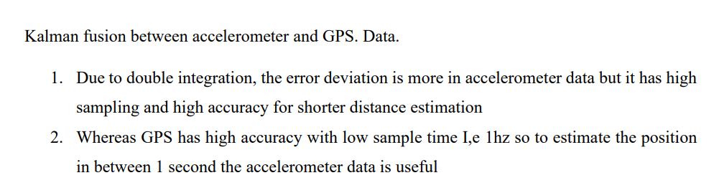
Kalman Estimation.

Slide 13
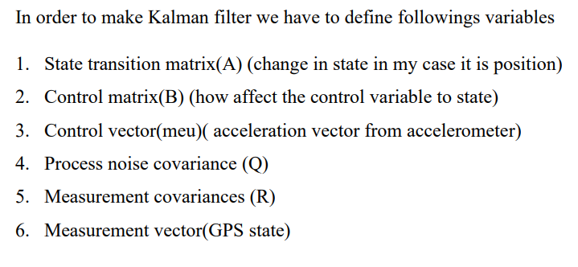
Kalman Estimation

Slide 14
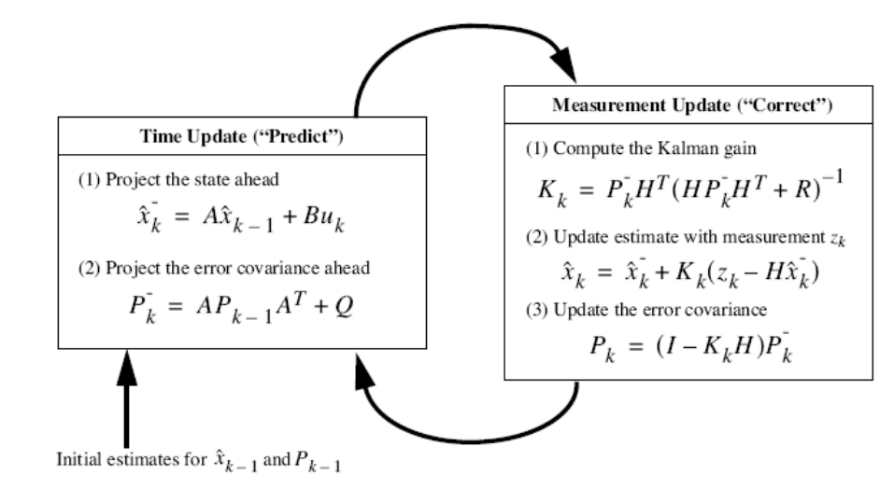
Kalman algorithm

Slide 15
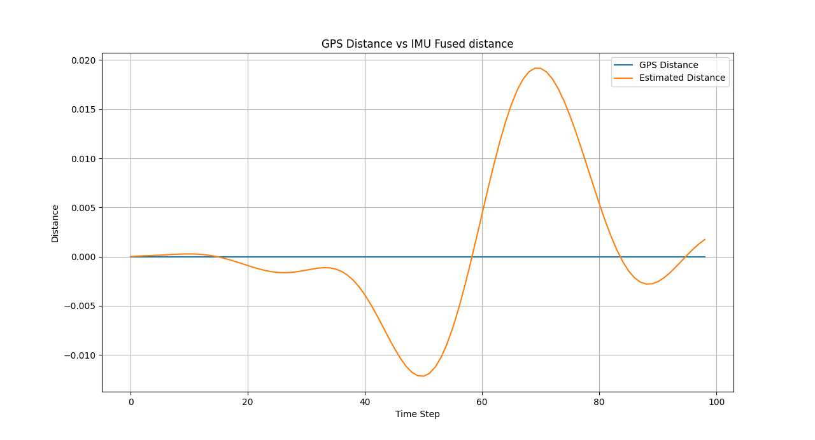
Visualizing with data output

Slide 16
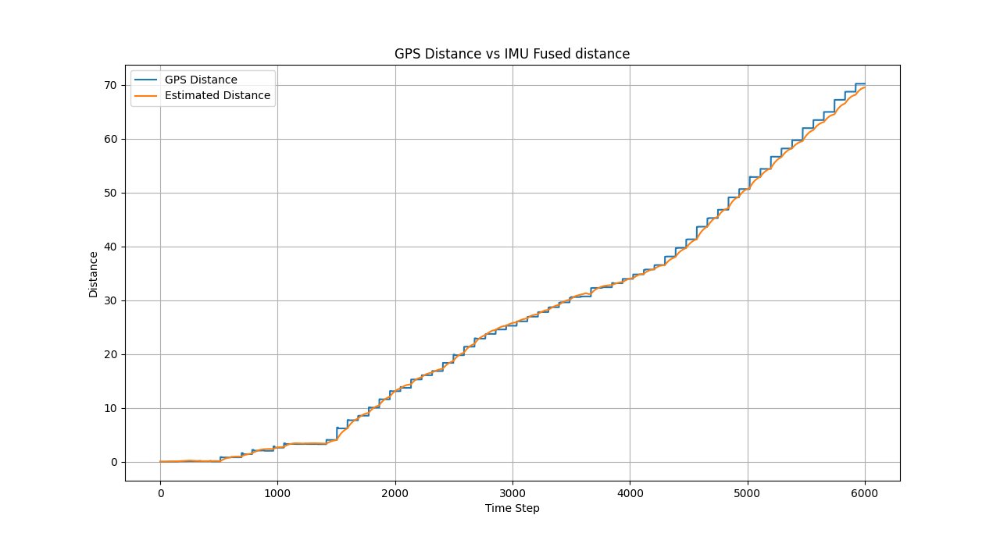
Visualizing with data output

Slide 17
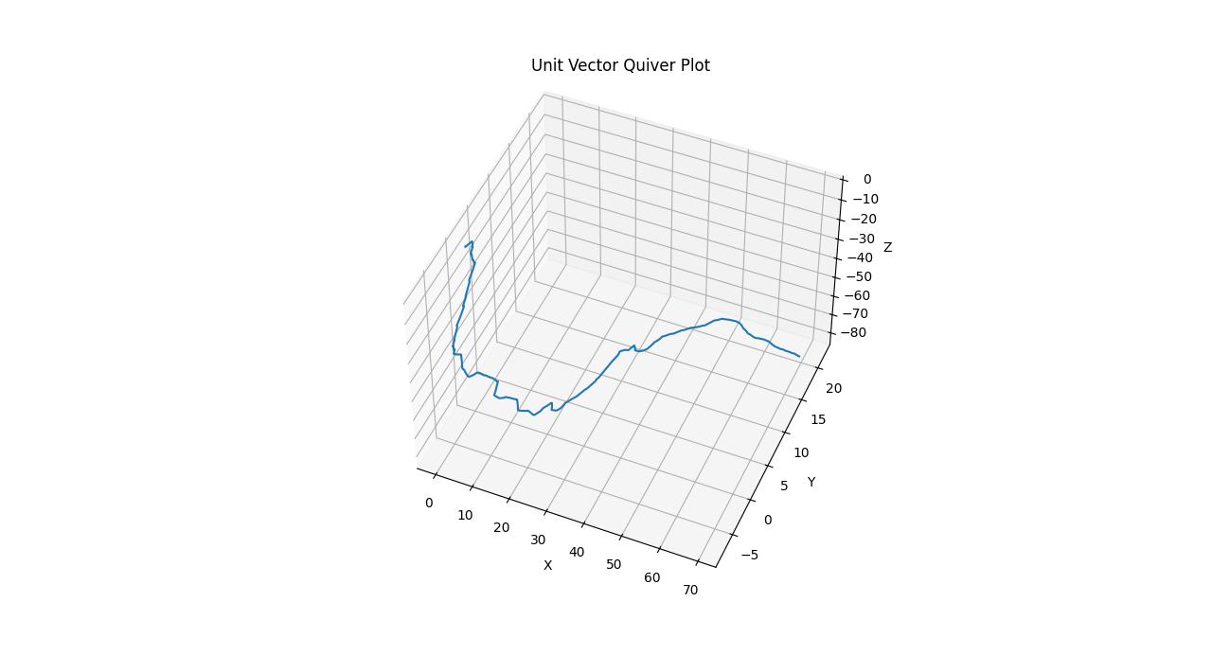
3D plot

Slide 18
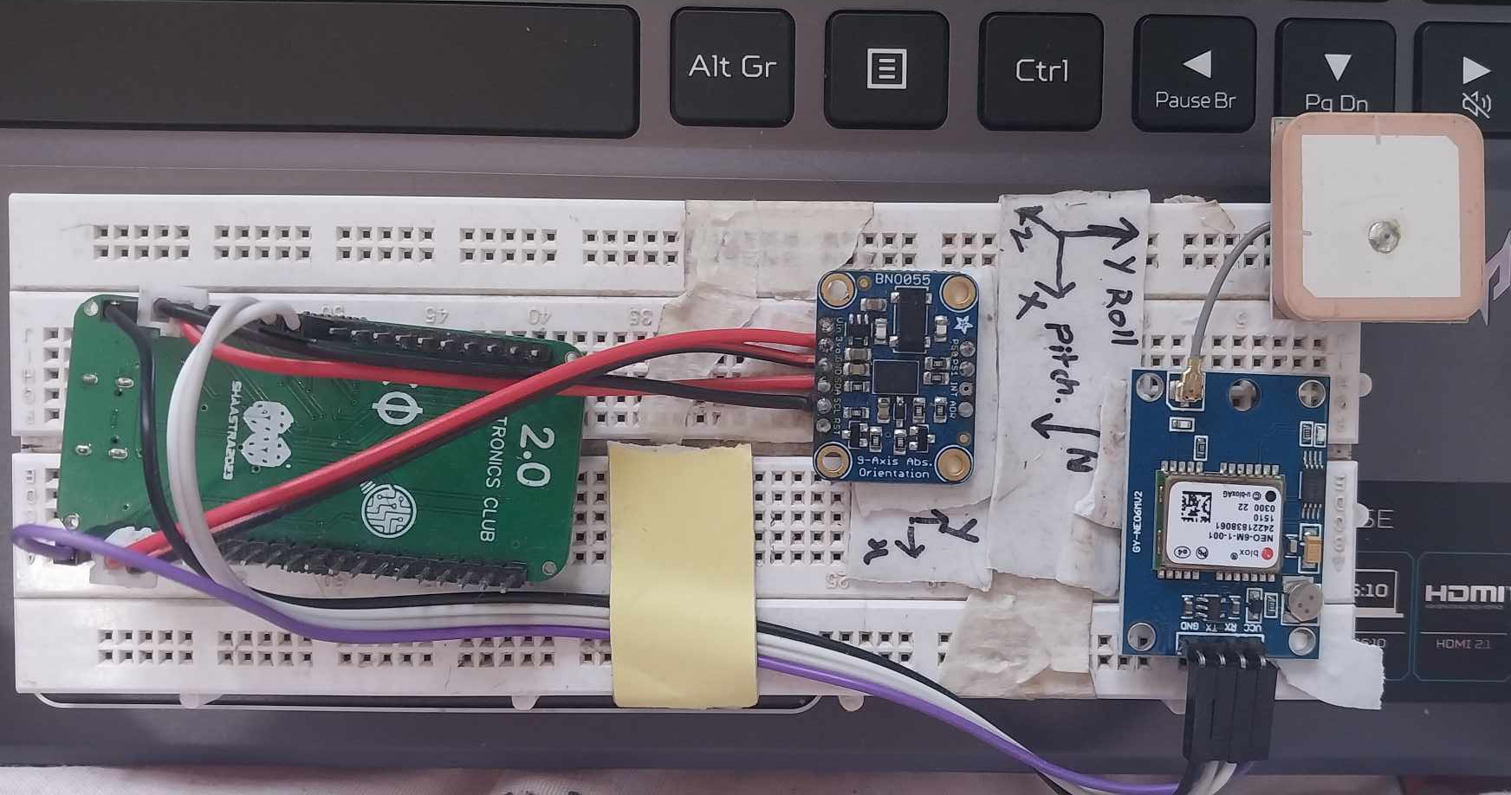
DEMO Time…….
Hardware….

Slide 19
Calibration.
Everytime whene Power up The board need to calibrate first so that it calculate and save offset values.
For more accuracy sprit level can be used.

